Slide 1
Framework Guidelines on Interoperability Rules: Problem Identification & Options
2nd Ad Hoc Expert Group Meeting 16/02/2012
TITRE

Slide 2
AGENDA
Interoperability : Problem Identification & Options
Introduction
Steps taken since the last Ad Hoc Expert Group Meeting
Problem identification, part of Impact Assessment
Problems identified so far by FG chapter
Next steps
2

Slide 3
On-going discussions since the Ad Hoc Expert Group Meeting on 7/11 :
Interoperability : Problem Identification Introduction : Timeline of the discussions
Six issues are identified since scoping exercise in 2011;
The drafting of the FG text is put on hold, as ACER decided internally to start the process of the initial impact assessment to support the FG text (problem inventory basis of today’s discussion);
Invitation letter of EC sent to ACER on 31/01/2012
Experts are asked to improve the analysis from ACER, by identifying supplementary problems that underpin clear policy options
3

Slide 4
Problem Identification
Interoperability : Problem Identification Introduction : Impact Assessment & Problem ID
First step of the Impact Assessment*;
ACER mandate: Art. 6(2) of the Gas Regulation : Each framework guideline shall contribute to non-discrimination, effective competition and the efficient functioning of the market.
Pragmatic translation of this mandate: carefully identified problems ensure that the Framework Guidelines deal with real regulatory issues.
* See impact assessment guidelines : http://ec.europa.eu/governance/impact/commission_guidelines/docs/iag_2009_en.pdf
4

Slide 5
Problem Identification: Goals*
Interoperability : Problem Identification Introduction : Impact Assessment & Problem ID
describe the nature of problem in clear terms and support the description with clear evidence ;
set out clearly the scale of the problem ;
set out clearly who is most affected by it ;
identify clearly the drivers or underlying causes of the problem ;
describe how the problem has developed over time and how existing policies at Community or Member State level affect it ;
identify a clear baseline, i.e. describe how the problem is likely to develop in the future without further EU action ;
identify clearly assumptions made, risks and uncertainty involved.
* See page 21 of the impact assessment guidelines
5

Slide 6
A problem to be tackled within a FG should :
Interoperability : Problem Identification Introduction : Impact Assessment & Problem ID
be specific enough to allow to establish the link between the remedies and the problem ;
require urgent solution, or happens along an identified timeline, as opposed to a problem that could only potentially occur (the latter to be tackled when it occurs -> amendment process) ;
should affect market players on a broad scale ;
Should occur at EU level, and not a regional one.
6

Slide 7
AGENDA
Interoperability : Problem Identification
Introduction
Problems identified by FG chapter
Introduction of the analysis
Nomination
Interconnection Agreements
Capacity Calculation
Gas Quality & Odorisation
Units Harmonisation
Data Exchange
Next steps
7

Slide 8
Introduction to the analysis
Interoperability : Problem Identification
Review of the issues
The next slides reflect ACER’s analysis, chapter by chapter, as also indicated in the problem identification questionnaire;
As an introduction, it is shown where we stand with the problem identification at this stage. This *.pptx therefore is only a “snapshot” and not the final conclusion to the discussions;
The aim of the today’s debate or discussion is the collection of further input, to amend and/or complete the views already expressed;
To be tackled first: “Nominations” in support of NC Balancing process.
8

Slide 9
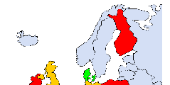
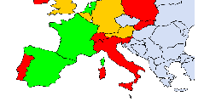
Nomination
Interoperability : Problem Identification
Review of the issues
Obstacle to the efficient functioning of the market : various nomination/re-nomination deadlines could be an obstacle to the development of short-term trading ;
Population affected and scale of the problem* :
* Implementation progress of the EASEE-gas CBPs 2010 review
9
Notes:
Examples have been find to identify that a lack of harmonisation related to nomination constitutes an obstacle to the efficient functioning of the market:
Case Example – Tarvisio/Arnoldstein IP – differing Nomination procedures as an obstacle to implementing capacity allocation;
Theoretical example to what extent different nomination/re-nomination/confirmation schedule may lead – but CBPs of EASEE-gas have offered a solution, especially in the Nord West;
identification of a barrier if no re-nomination possibilities exist at on e side of the IP.
If this is the baseline scenario, as indicated in the map of Europe, are there more specific examples at hand that illustrate that more harmonised rules are needed?

Slide 10
Nomination
Interoperability : Problem Identification
Review of the issues
Baseline scenario includes interaction with existing policies :
strong interactions with the FG CAM (not specific on European measures);
CMP (short term UIOLI procedure);
FG Balancing (harmonisation at both sides of the border at IPs and consistently across Europe.
What aspects of nomination regimes need to be harmonised :
timing of day-ahead entry/exit nominations - time window for re-nominations?
minimum re-nomination lead-times - confirmation timing?
existence of daily and hourly nomination schedules?
EASEE-gas CBP issues : “handling mismatches” or “message content” ?
What drivers push for inclusion of more than just IPs between TSOs
from TSO - network user – adjacent operator perspective: potential conflicts?
10

Slide 11
Interconnection Agreements
Interoperability : Problem Identification
Review of the issues
no evidence found to substantiate that there is a problem ;
only indirect evidence to reach bilateral agreements is provided, and the need for improvement of TSO cooperation;
can you provide a specific example of a problem resulting from:
the none existence of an interconnection agreement?
a lack of harmonisation regarding such an agreement?
to be able to identify the options at hand:
case by case resolution: no specific guidance ;
harmonisation of the format of the interconnection agreement;
harmonisation of the format and content of the interconnection agreement.
no evidence found to extend the scope to storage and LNG terminals.
11
Notes:
OPTION 2.a - case by case resolution: no specific guidance, but in case no bilateral or regional agreement (regional resolution of issues within the GRIs) is reached and regulators cannot solve the issue, the case goes to ACER;
OPTION 2.b - harmonisation of the format of the interconnection agreement, specifying a template or a list of issues to be tackled as a minimum, on which to base a case by case approach;
OPTION 2.c - harmonisation of the format and content of the interconnection agreement, specifying a list of issues to be tackled, as well as detailed default rules when no agreement is reached.

Slide 12
Interconnection Agreements
Interoperability : Problem Identification
Review of the issues
Business Rules;
Technical Rules;
Data exchange: Communication and Online Data Transmission
Duration (when the Interconnection Agreement becomes effective and until when it shall remain in force)
Confidentiality
Liability and Circumstances Excluding Liability
Governing Law and Dispute Resolution
Amendment of the IA
Relation to other agreements
Force Majeure
12
Notes:
Business Rules
Shipper’ registration
Matching rules and Scheduling Process (programming and matching purposes)
Flow Control/Imbalance handling
Exception notices (in case of deficient gas quality)
Allocation regime (e.g. OBA, Pro-rata, BSA) and the communication of the allocation data (shipper detail).
Technical Rules
Maintenance
Energy and Quality Measurement
Right of Access
Exceptional flow conditions in circumstances which might cause capacity reductions
Delivery conditions
Gas pressure
Gas temperature
Gas quality
Energy conversion
11. Do you agree with the content of this list?
12. Are there additional issues that you would include and others you would exclude?
13. Can you relate your answer to any practical problem that you faced?
14. Apart from a minimum list of items to be tackled, would you like the FG to set out guidance on additional issues (rules on revisions of IAs etc.) ?

Slide 13
Capacity Calculation
Interoperability : Problem Identification
Review of the issues
Gas Regulation Art. 16: « The maximum capacity at all relevant points (…) shall be made available to market participants, taking into account system integrity and efficient network operation.»;
D. Maximum commercial capacity
A. Physical capacity calculation
B. System integrity
C. Efficient Network Operation
to your knowledge, is there a direct relation between physical and commercial capacity? Is it possible to optimise the physical capacity calculated by TSOs? Please provide justification.
13
Notes:
“The Task Force defined the maximum capacity as the difference between physical capacity calculated and the sum of the capacities required for system integrity and efficient network operation”
Question to be read as “is there an example where the maximum offered is clearly not the maximum.”

Slide 14
Capacity Calculation
Interoperability : Problem Identification
Review of the issues
requires the current legal framework improvement in order to ensure the required levels of Transparency and TSO Cooperation to ensure that maximum capacity is made available?
what are the drivers or underlying causes of the problem, a lack of harmonisation :
in the physical capacity calculation;
in the network operation procedures;
in the scenarios used;
in the frequency of capacity recalculation?
for the baseline scenario: is interaction with Transparency, CAM, CMP to be considered?
14
Notes:
OPTION 1: no further harmonisation
OPTION 2: Transparency – harmonisation on the publication (format, content and periodicity) of maximum capacity at each side of the border, input parameters related to capacity calculation and extreme scenarios.
OPTION 3: Transparency, update and cooperation – Transparency requirements include harmonisation on the publication (format, content and periodicity) of maximum capacity at each side of the border, input parameters related to capacity calculation and extreme scenarios. Cooperation requirements include the necessity for TSOs to work on maximum capacity discrepancies at each side of the border. A case-by-case approach will apply. If no bilateral agreement is reached and regulators cannot solve the issue, the case goes to ACER.

Slide 15
Capacity Calculation
Interoperability : Problem Identification
Review of the issues
Options:
1: no further harmonisation;
2: transparency, harmonisation on the publication Transparency;
3: update and cooperation
Possible identified input parameters as referred to in option 3 could be: temperature
pressure, compression power
elevation
gas compressibility
gas density
friction factor, roughness of the pipe, viscosity of the gas
Which parameters to include? In relation to which practical problem
Which would be a relevant periodicity for providing an update on physical capacity calculation parameters and extreme operating scenarios
15
Notes:
OPTION 1: no further harmonisation
OPTION 2: Transparency – harmonisation on the publication (format, content and periodicity) of maximum capacity at each side of the border, input parameters related to capacity calculation and extreme scenarios.
OPTION 3: Transparency, update and cooperation – Transparency requirements include harmonisation on the publication (format, content and periodicity) of maximum capacity at each side of the border, input parameters related to capacity calculation and extreme scenarios. Cooperation requirements include the necessity for TSOs to work on maximum capacity discrepancies at each side of the border. A case-by-case approach will apply. If no bilateral agreement is reached and regulators cannot solve the issue, the case goes to ACER.

Slide 16
Gas Quality
Interoperability : Problem Identification
Review of the issues
differences in gas quality specifications (Wobbe, ...) at either side of an IP exist;
To what extent is it a direct problem that hampers the good functioning of the market (management of differences by network users);
To be seen as a bilateral, regional or European issue?
baseline scenario : with the current flow patterns, the differences in gas quality specifications are managed by the TSOs and do not hamper cross-border flows at the EU level;
Flow patterns could evolve with the level of internal market development and security of supply requirements. However, no time horizon or evolution of the scale of the problem was not identified up to now;
16
Notes:
First bullet: see ENTSOG Transparency platform

Slide 17
Gas Quality
Interoperability : Problem Identification
Review of the issues
Options:
1. No further EU action;
2. TSO cooperation on handling differences in gas quality & case by case approach with intervention by regulators and ACER;
3. TSO cooperation and default rule on sharing costs and responsibilities for measures related to the management of gas quality differences
Do other options exist?
17
Notes:
Based on the analysis conducted by the task force, the following options are being discussed
OPTION 1: No further EU action;
OPTION 2: TSO cooperation on handling differences in gas quality & Case by case approach with intervention by regulators and ACER where bilateral problems due to gas quality cannot be solved by TSOs in a way that ensures proper functioning of the market and unhampered trade;
OPTION 3: TSO cooperation and default rule on sharing costs and responsibilities for measures related to the management of gas quality differences (i.e. the EASEE-gas CBP approach or a cost-benefit analysis approach where costs of swapping, co-mingling or blending in the systems concerned are compared).

Slide 18
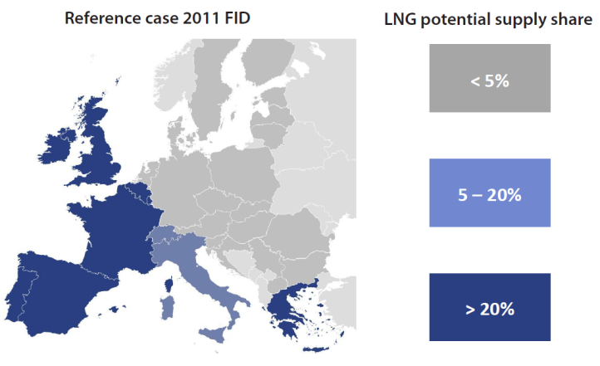
Odorisation
Interoperability : Problem Identification
Review of the issues
is identified as a barrier to market integration;
a local problem but with trans-regional consequences;
Specific problems at hand?
Options:
1. no further EU action;
2. case by case resolution;
3. harmonisation rule;
Do other options exist?
18
Notes:
OPTION 1: No harmonisation;
OPTION 2: case by case resolution: no specific guidance, but in case no bilateral or regional agreement (regional resolution of issues within the GRIs) is reached and regulators cannot solve the issue, the case goes to ACER;
OPTION 3: Harmonisation rule: odorisation practices shouldn’t hamper cross-border flows.

Slide 19
Units Harmonisation
Interoperability : Problem Identification
Review of the issues
barrier to trade & inefficient functioning of the market being identified:
various unit references add complexity and costs to the daily activity of network users;
How to judge the scale of the problem : between network users, traders, transmission system operators, other adjacent operators?
EASEE-gas CBP provides for a solution:
Could that be considered as “the solution”?
Are there any other alternatives?
19

Slide 20
Data Exchange
Interoperability : Problem Identification
Review of the issues
barrier to trade and discrimination : various data formats add IT costs to the daily activity of network users. The entry cost might penalise small shippers more than incumbents;
Can a specific example of a problem resulting from a lack of harmonisation regarding data exchange be provided?
Options*:
1. no further EU action;
2. guidance – handbook on a voluntary basis;
3. harmonisation with binding rules;
Do other options exist?
* Note: the legal feasibility of the following options has to be further assessed. For the sake of discussion, all of them are assumed to be legally valid options
20

Slide 21
Data Exchange
Interoperability : Problem Identification
Review of the issues
Possible identified topics to be included in a handbook could be:
data exchange protocol and format (with reference to EDIG@S)
confidentiality & Security
implementation guidelines
development of new technical solutions
core content of the messages
Are there topics that you would include or exclude?
Can you relate your answer to any practical problem that you faced
21

Slide 22
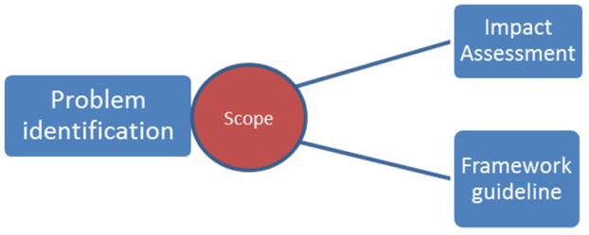
Next steps :
Interoperability : Problem Identification
Review of the issues
Way forward:
TF to proceed with the selection of the relevant problems and find adequate policy solutions;
“Nominations” to be taken over within Balancing development process;
Next deadline: Launch of consultation on IA and FG in March
22

Slide 23
Thank you for your attention!
Thank you for your attention
www.acer.europa.eu

